Slide 1
Aviation Operational Intelligence Analysis: A look at the flight hour and maintenance requirements of a high tempo flight school.
Matthew Brady, Dillon Wollberg
Background
Intent
Our project will analyze operational flight and maintenance data from Western Michigan University's (WMU) flight school, integrated with meteorological data, to uncover patterns in flight activity and operational constraints. By combining these diverse sources, we aim to identify trends, quantify environmental and technical impacts on flight schedules, and examine maintenance demands over time.
Aircraft maintenance is a cornerstone of aviation safety and operational efficiency. While environmental factors—especially weather conditions such as temperature, precipitation, wind speed, and humidity—are often assumed to influence maintenance needs, the exact nature of these relationships remains underexplored. This is particularly relevant in a flight training environment, where aircraft availability is closely tied to weather-dependent scheduling.
This project seeks to answer key questions:
Does adverse weather contribute to increased maintenance activity?
What is the distribution of downed events across aircraft in the fleet?
How does average downtime vary by maintenance reason?
By addressing these questions, we aim to generate actionable insights that support more predictive, data-informed maintenance scheduling and reduce unplanned operational disruptions. Our findings will help validate or challenge existing assumptions about the role of weather in aircraft maintenance, while also identifying new opportunities to optimize flight scheduling and resource allocation.

Slide 2

Data Sources
Western Michigan University Resources Maintenance System (RMS)
Limited access to School of Aviation flight resources. It is used to log operational data for the flight service center and maintenance activities.
National Oceanic Atmospheric Administration (NOAA)
The most reputable meteorological weather data source in North America. This source will be used to analyze environmental impacts on flight scheduling.
Local Climatological Data (LCD) from the weather station at the Battle Creek Executive Airport at Kellogg Field, home of the WMU College of Aviation. The LCD contains daily/hourly/monthly conditions for temperature, precipitation, wind speed/direction, sky conditions, etc.
Website | GitHub
File type | .csv
Access Method | Download
File Size | 246.4KB (2 files)
Data Type | str/object
Records | 901 rows X 8 columns
Time Period | 01/01/2024 – 12/31/2024
Location | Battle Creek Kellogg Airport, MI
Website | noaa.gov
File type | .csv
Access Method | Download
File Size | 3.83 MB
Data Type | str/object
Records | 12,275 rows X 91 columns
Time Period | 01/01/2024 – 12/31/2024
Location | Battle Creek Kellogg Airport, MI

Slide 3
Data Manipulation
NOAA Data
RMS Flight Service Data
NOAA.py
Filtered out unwanted REPORT_TYPEs “SOD”, and “SOM”.
df_A() Extracts hourly weather columns to build base dataframe and converts dates to datetime.
extract_metar_text(line) Removes extra timestamps from a line.
decode_metar(metar) Parses the METAR strings into dataframe columns.
df_B() Applies decode_metar to make a clean dataframe.
NOAA_to_float_and_interpolate() Removes "HourlySkyConditions" and "HourlyPresentWeatherType" for simplicity then converts all remaining columns to floats and linearly interpolates missing values.
change_NOAA_columns() Renamed columns for clarity.
add_avg_prev_columns() For each numerical column, adds a new column containing the average of the previous 5 days using pandas.DataFrame.rolling method.
get_cleaned_NOAA_df() Runs the whole cleaning pipeline.
historical_data.py
Not used in the final analysis.
Includes a comment column, possibly for machine learning.
Includes RMS reported descriptive statistics to track how much the data has changed due to cleaning.
reason_data.py
imports Resources Downed by Reason and drops an aircraft that was sold from the csv.
downed() Nested function concatenates “squawk” and “reason” columns. Converts data types. Cleaning removed 6.65 years from the fleet sum downtime.
map_reason() maps and filters the most descriptive reason the aircraft was removed from service.
complete_duration() Handles NaN from calculated duration out of service by imputing RMS calculation.

Slide 4
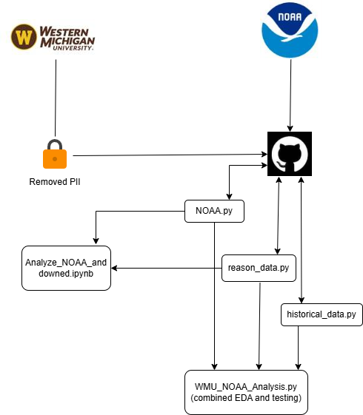
Data Manipulation
Merging NOAA and downed
Used merge_asof to avoid creating erroneous duplicate rows and match each downed event with the most recent prior weather report.
Dropped events occurring before available weather data.
Events with general or scheduled reasons (50 Hr Inspect, 100 Hr Inspect, Annual Inspect, and Unspecified) were excluded to focus analysis on operationally meaningful maintenance causes.
Key variables are defined for later analysis:
reason_counts: Frequency of each maintenance reason.
reasons_terms: List of unique reasons.
aircraft_counts: Frequency of downed events by aircraft.
avg_cols: Columns representing 5-day averages of weather variables.
A custom Seaborn color palette, our_colors, was created using Pastel1, mapping consistent colors to each downed reason for use in categorical visualizations.

Slide 5
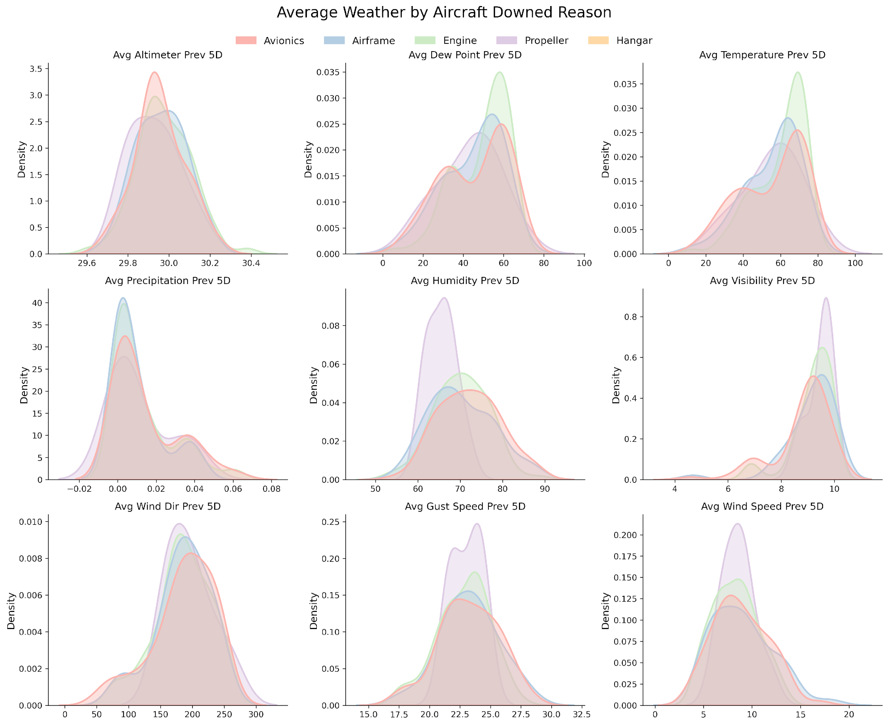
Does Adverse Weather Contribute to Increased Maintenance Activity?
Kernel Density Estimates (KDEs)
To explore this question, we used KDEs arranged in a grid to examine the relationship between weather variables and aircraft downtime reasons.
Interestingly, across all KDEs, favorable weather conditions consistently showed higher densities of maintenance-related groundings. The same conditions most suitable for flying.
This suggests that maintenance issues are more likely driven by wear and tear associated with higher flight frequency, rather than directly caused by adverse weather. Implying that aircraft tend to require maintenance when they are flown more often, which naturally occurs under good weather conditions.

Slide 6
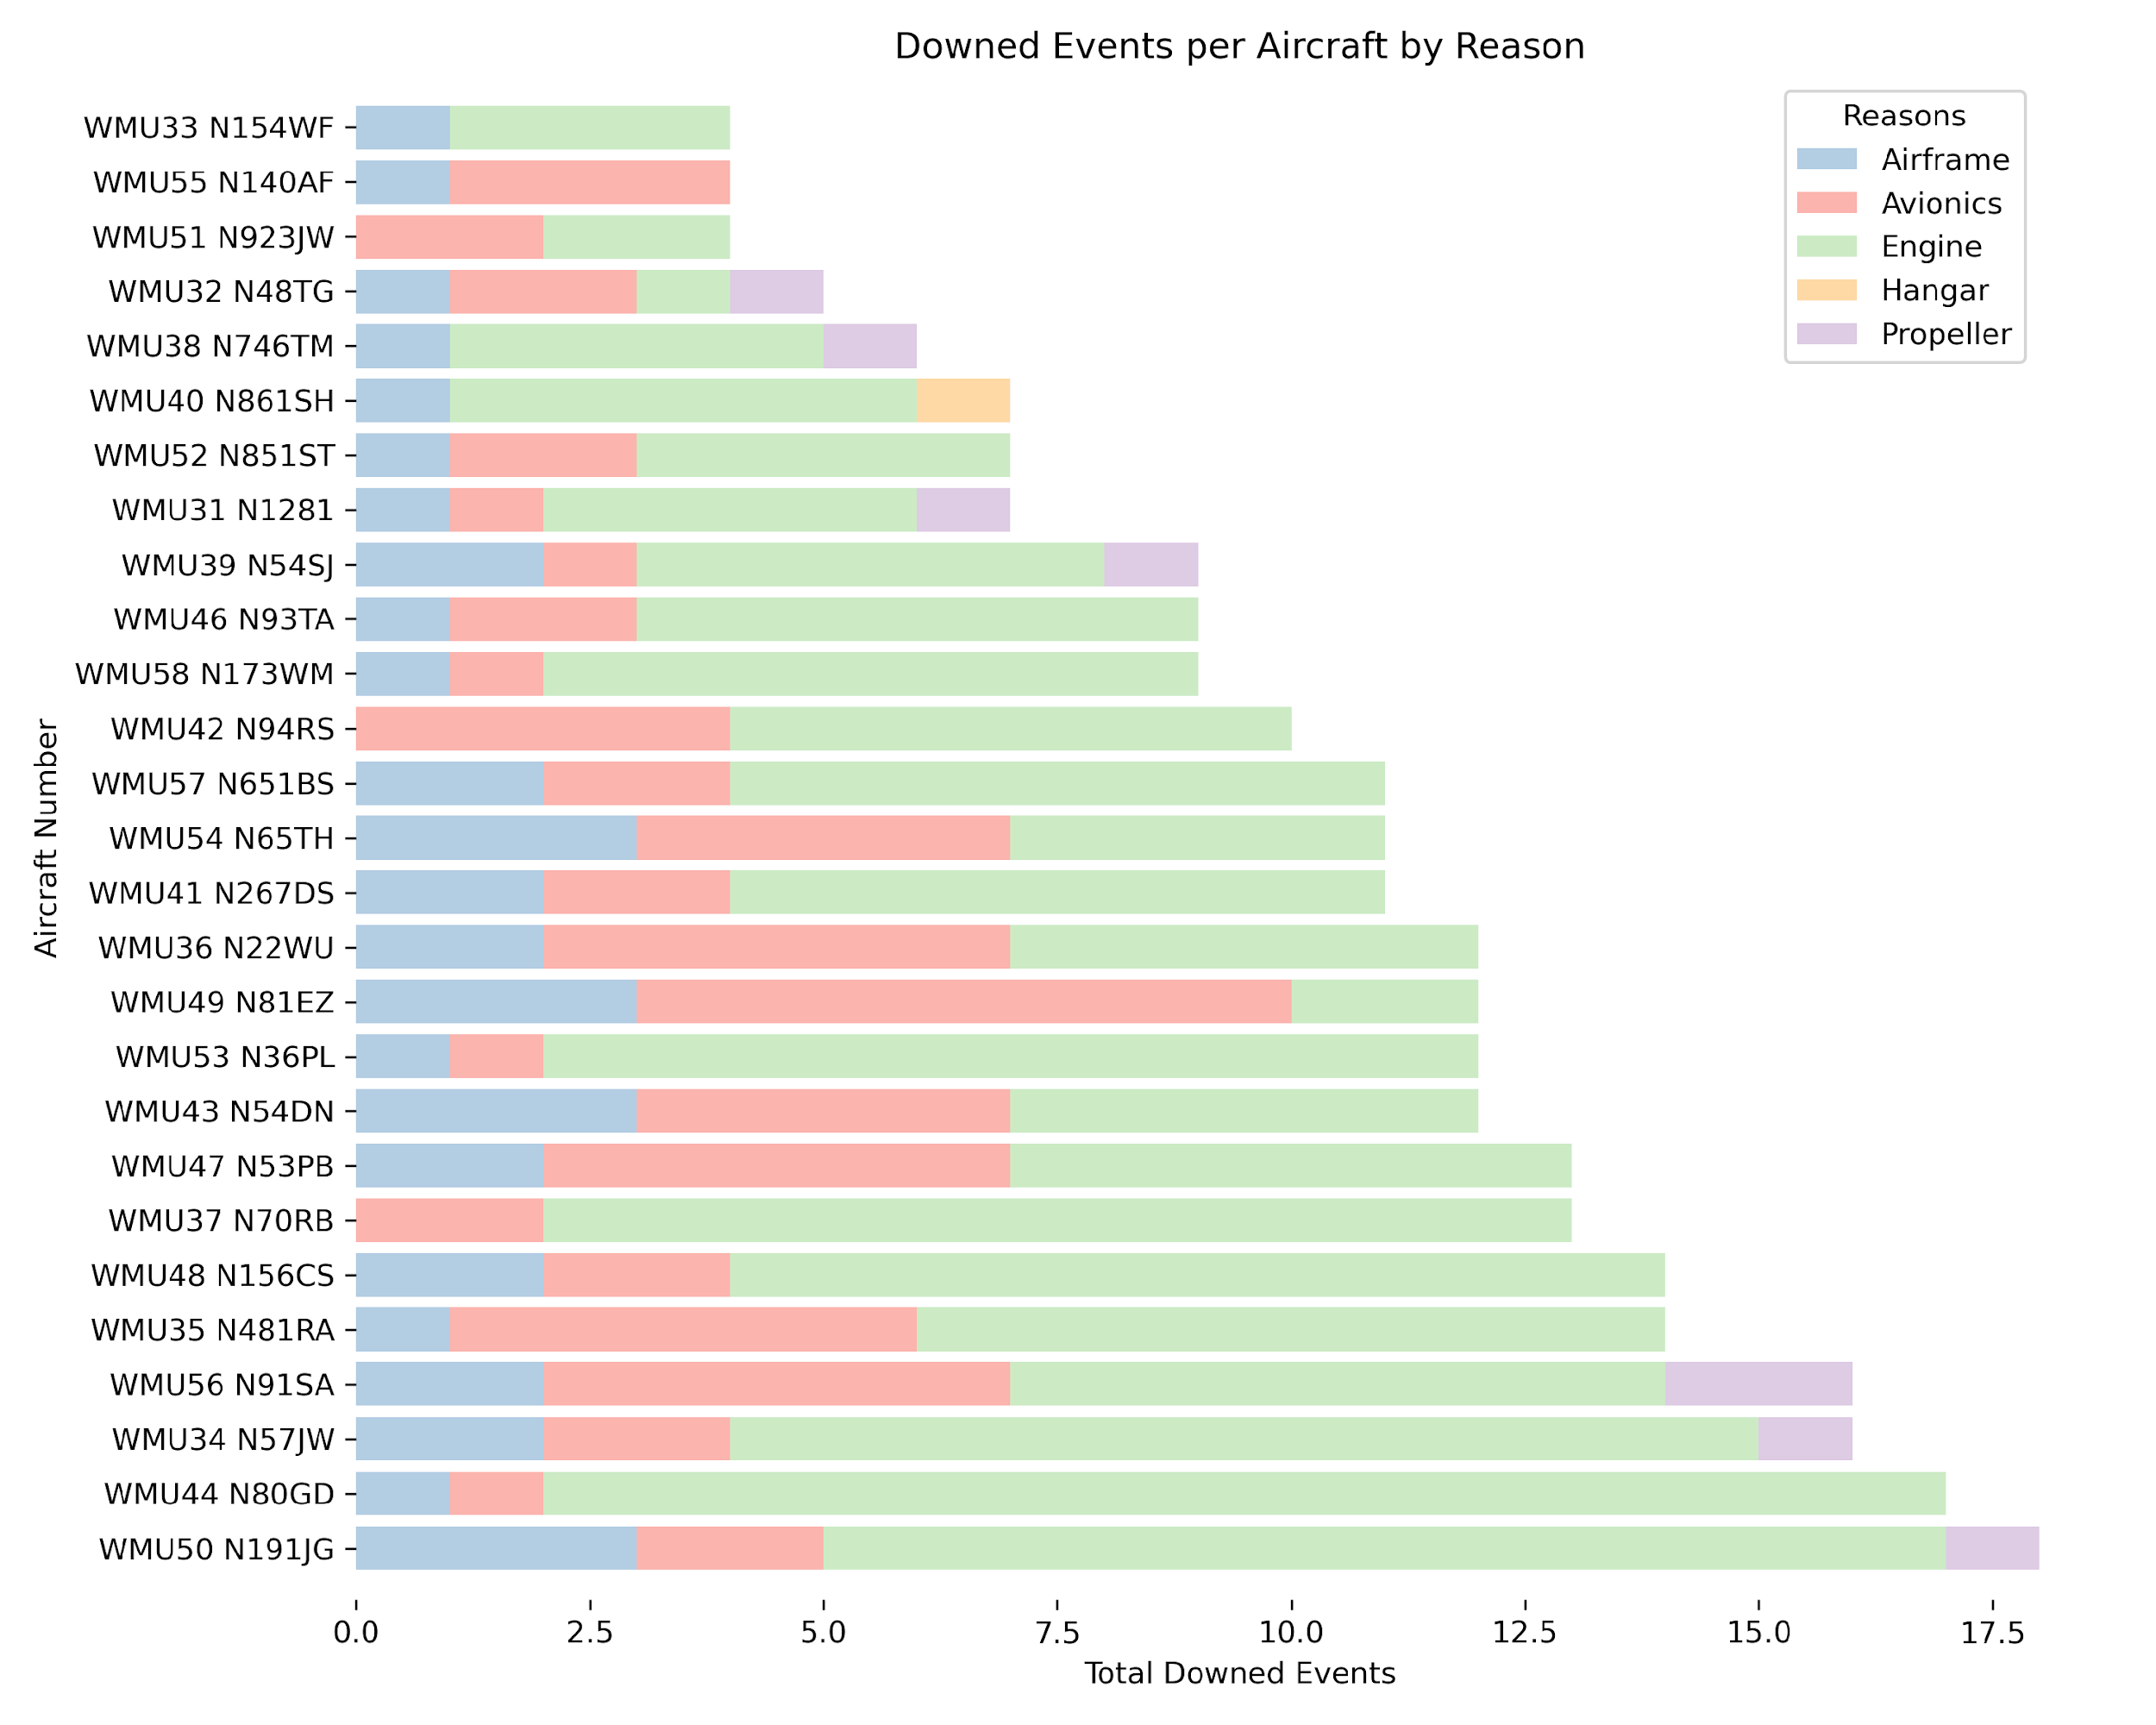
Distribution of Downed Events Across Aircraft Fleet
Stacked Horizontal Bar Chart
To investigate aircraft-level variation in maintenance activity, we analyzed the distribution of downed events by tail number, with each aircraft uniquely identified in the dataset.
The results reveal variability in both the frequency and nature of reported downed events across all aircraft at WMU.
Engine: 167
Avionics: 67
Airframe: 40
Propeller: 8
Hangar: 1
These totals indicate that engine-related issues account for most maintenance events across the fleet, followed by avionics and airframe-related causes.

Slide 7
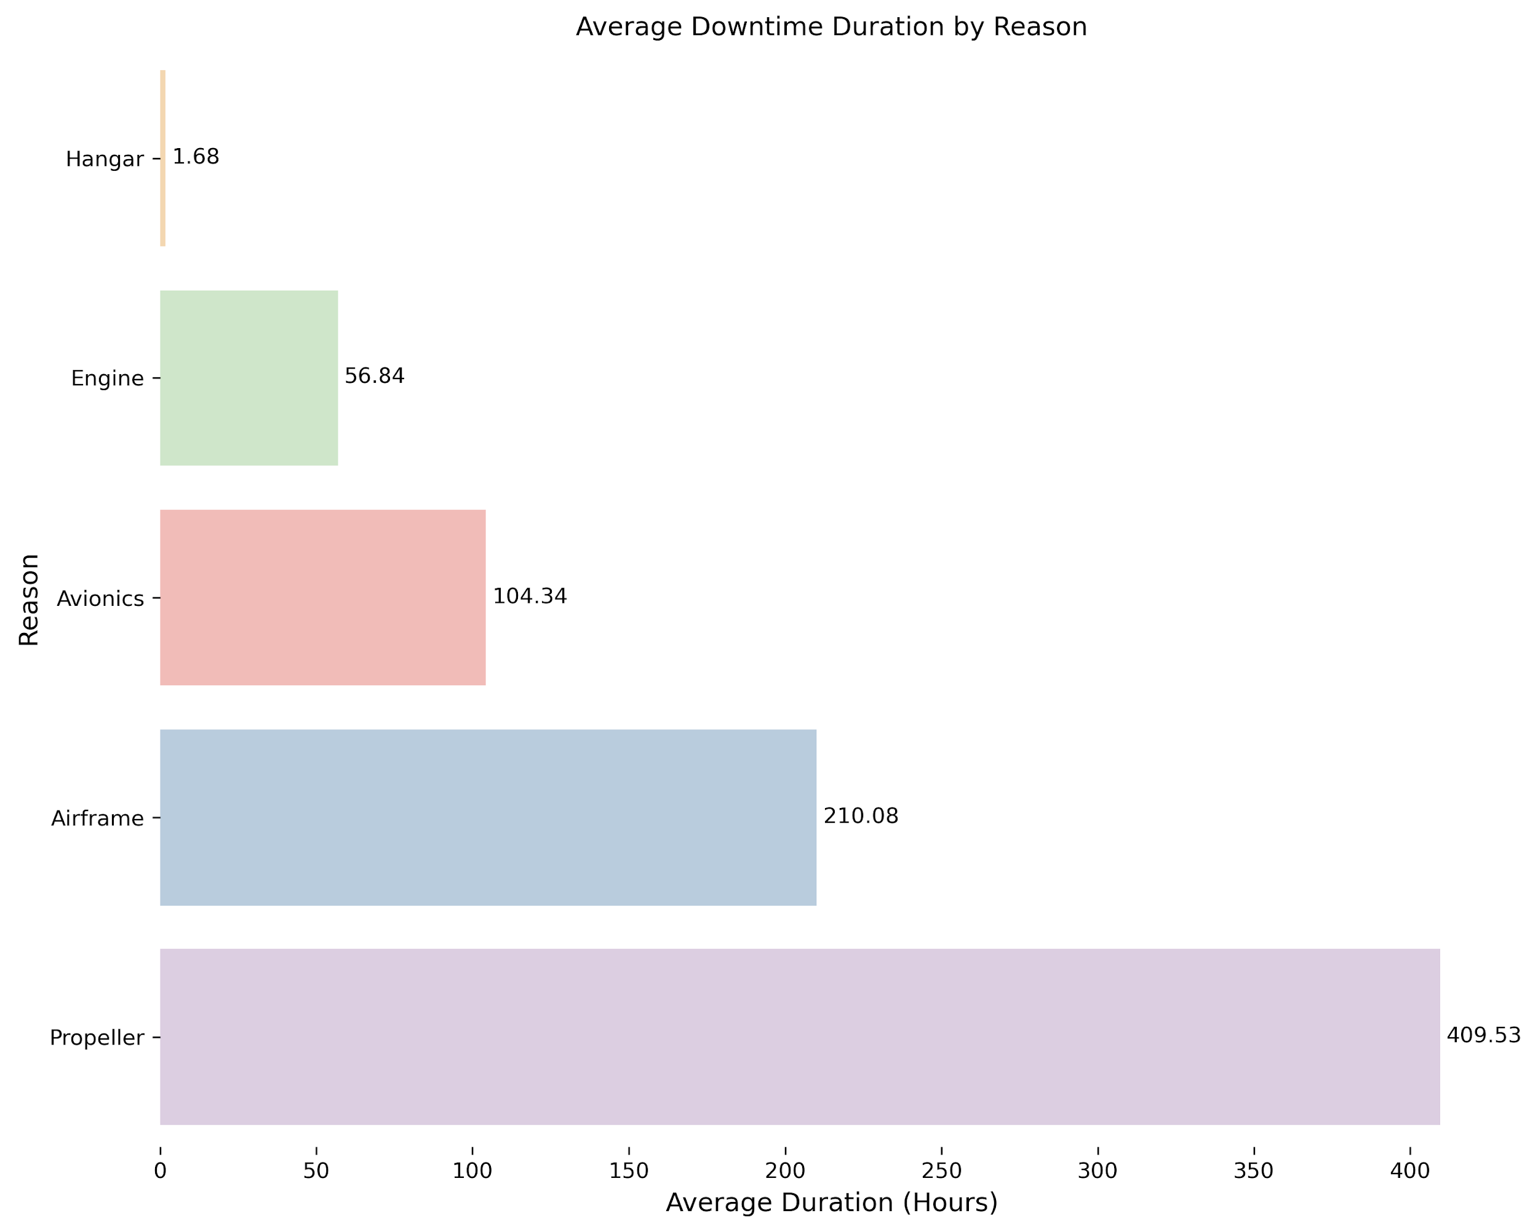
Average Downtime by Maintenance Reason
Horizontal Bar Chart
To assess the impact of different maintenance issues on operational availability, we analyzed the average duration of downed events by maintenance reason.
A horizontal bar chart was used to visualize the mean downtime, measured in hours, for each category.
These findings indicate that propeller and airframe issues result in the longest average downtimes, suggesting that they may involve more complex or time-consuming repairs.
In contrast, engine and avionics issues, while more frequent, are resolved quickly on average.

Slide 8
Summary
Further analysis
Weather conditions influence the frequency of downed aircraft, but its not necessarily causation. The conditions associated with high rates of maintenance issues coincide with good flying conditions, especially at a flight school for learning pilots.
The horizontal bar chart which summarized mean downtime by maintenance category reveals interesting insight. First, the categories are by shop/mechanic certification. For example, the “Airframe” category is not just structural. “Airframe” includes all systems and subsystems that are not “Engine”, “Propeller”, or “Avionics” (which can include some power distribution).
The mean airframe category downtime of 210.1 hours and a mean propeller downtime of 409.5 hours is unexpected, considering system complexity. If there was a spare propeller program this suggests that the inventory could be adjusted.
Decode the skyconditions from NOAA_df.
Compare flight frequency/flight hours per aircraft to downed events.
Incorporate the Comments from downed_df for more specific aircraft system vulnerabilities.
Follow up with a qualitative data analysis to better understand system vulnerabilities.
Follow up with a qualitative data analysis to better understand what the unspecified squawks should be.
Follow up with a qualitative data analysis to better understand propeller down time.
The association between the 50 Hr inspection and engine down time could be checked.
Root cause analysis to follow

Slide 9
Challenges
Decoding METAR reports was extremely tedious.
Custom logic was required to turn raw aviation weather strings into usable data.
NOAA_df contained multiple readings for each day. Merging NOAA_df and downed_df on datetime caused duplicate counts for downed events.
merge_asof prevented duplicate rows.
Filling NANs with zeros caused false data.
Linear interpolation was utilized instead.
Using iterrows to iterate through the NOAA_df and average the prev_days took nearly 10 minutes.
rolling decreased the time significantly.
Setting the legend for the KDE grid was exhausting because Seaborn’s kdeplot does not allow easy customization.
A “fake” plot with only a legend was overlayed on the KDE grid.

Slide 10
Ethical Considerations
The primary dataset includes references to specific individuals (e.g., pilots, instructors) and possibly identifiable squawk descriptions. To maintain ethical integrity:
There are some names of individuals in the primary dataset. Their names are not essential, so they can just be removed.
Some squawks may identify people or incidents in embarrassing ways. Categorizing squawks by system or scheduled event will protect reputations by providing anonymity.

Slide 11
Statement of Work
References
Dillon Wollberg
Obtained permission to use WMU data.
Obtained anonymous WMU source data and started a public GitHub repository.
Wrote reason_data.py
Wrote historical_data.py
Wrote NOAA.py (90 lines of it).
Wrote EDA code WMU_NOAA_analysis (50 lines of it).
Performed summary analysis in part (did not write code).
Matthew Brady
Sourced NOAA data.
Contributed to cleaning NOAA.py.
Developed merging strategy and visualizations in Analyze_NOAA_and_downed notebook.
Report content editing.
Github:
https://github.com/wolldg/SIADS-Milestone-1
NOAA Data:
https://www.ncei.noaa.gov/
Jupyter Files:
Analyze_NOAA_and_downed.ipynb
historical_data.py
reason_data.py
NOAA.py
Code Diagram:
draw.io

